Slide 1
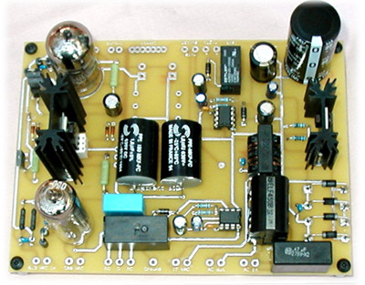
Electronics Overview
diode bridge
Basic Circuits, Power Supplies,
Transistors, Cable Impedance
Notes:
Electronics Overview
Lecture 8

Slide 2
Basic Circuit Analysis
UCSD: Physics 121; 2012
What we won’t do:
  common electronics-class things: RLC, filters, detailed analysis
What we will do:
  set out basic relations
  look at a few examples of fundamental importance (mostly resistive circuits)
  look at diodes, voltage regulation, transistors
  discuss impedances (cable, output, etc.)
Winter 2012
Notes:
Electronics Overview
Lecture 8

Slide 3
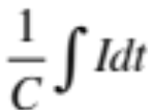
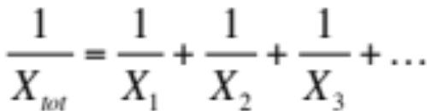
The Basic Relations
UCSD: Physics 121; 2012
V is voltage (volts: V); I is current (amps: A); R is resistance (ohms: Ω); C is capacitance (farads: F); L is inductance (henrys: H)
Ohm’s Law: V = IR; V = ; V = L(dI/dt)
Power: P = IV = V²/R = I²R
Resistors and inductors in series add
Capacitors in parallel add
Resistors and inductors in parallel, and capacitors in series add according to:
Winter 2012
Notes:
Electronics Overview
Lecture 8

Slide 4
Example: Voltage divider
UCSD: Physics 121; 2012
Voltage dividers are a classic way to set a voltage
Works on the principle that all charge flowing through the first resistor goes through the second
  so ΔV ∝ R-value
  provided any load at output is negligible: otherwise some current goes there too
So V_{out} = V(R₂/(R₁ + R₂))
R₂ here is a variable resistor, or potentiometer, or “pot”
  typically three terminals: R₁₂ is fixed, tap slides along to vary R₁₃ and R₂₃, though R₁₃ + R₂₃ = R₁₂ always
R₁
V
V_{out}
1
R₂
3
2
Winter 2012
Notes:
Electronics Overview
Lecture 8

Slide 5
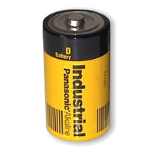
Real Batteries: Output Impedance
UCSD: Physics 121; 2012
A power supply (battery) is characterized by a voltage (V) and an output impedance (R)
  sometimes called source impedance
Hooking up to load: R_{load}, we form a voltage divider, so that the voltage applied by the battery terminal is actually V_{out} = V(R_{load}/(R+R_{load}))
  thus the smaller R is, the “stiffer” the power supply
  when V_{out} sags with higher load current, we call this “droop”
Example: If 10.0 V power supply droops by 1% (0.1 V) when loaded to 1 Amp (10 Ω load):
  internal resistance is 0.1 Ω
  called output impedance or source impedance
  may vary with load, though (not a real resistor)
R
V
D-cell example: 6A
out of 1.5 V battery
indicates 0.25 Ω output
impedance
Winter 2012
Notes:
Electronics Overview
Lecture 8

Slide 6
Power Supplies and Regulation
UCSD: Physics 121; 2012
A power supply typically starts with a transformer
  to knock down the 340 V peak-to-peak (120 V AC) to something reasonable/manageable
We will be using a center-tap transformer
  (A’ − B’) = (winding ratio)×(A − B)
    when A > B, so is A’ > B’
  geometry of center tap (CT) guarantees it is midway between A’ and B’ (frequently tie this to ground so that A’ = −B’)
  note that secondary side floats: no ground reference built-in
A
A’
AC input
CT
AC output
B
B’
Winter 2012
Notes:
Electronics Overview
Lecture 8

Slide 7
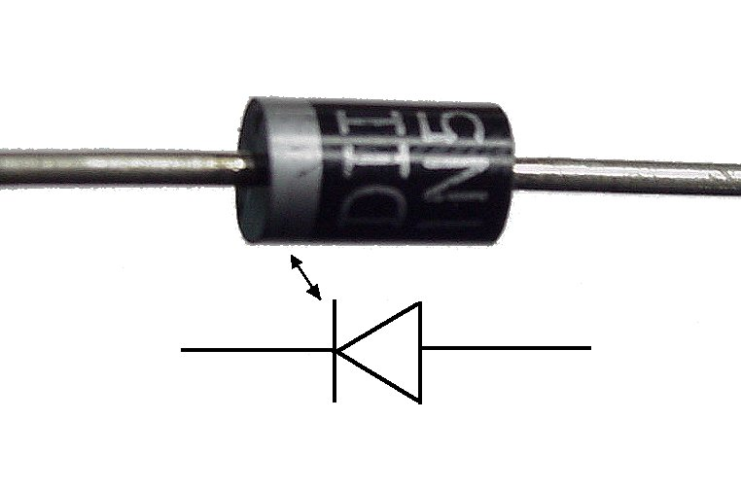
Diodes
UCSD: Physics 121; 2012
Diodes are essentially one-way current gates
Symbolized by:
Current vs. voltage graphs:
acts just like a wire
(will support arbitrary
current) provided that
voltage is positive
I
I
I
I
V
V
0.6 V
V
V
plain resistor
diode
idealized diode
WAY idealized diode
the direction the
arrow points in the
diode symbol is the
direction that current
will flow
no current flows
current flows
Winter 2012
Notes:
Electronics Overview
Lecture 8

Slide 8
Diode Makeup
UCSD: Physics 121; 2012
Diodes are made of semiconductors (usually silicon)
Essentially a stack of p-doped and n-doped silicon to form a p-n junction
  doping means deliberate impurities that contribute extra electrons (n-doped) or “holes” for electrons (p-doped)
Transistors are n-p-n or p-n-p arrangements of semiconductors
p-type
n-type
Winter 2012
Notes:
Electronics Overview
Lecture 8

Slide 9
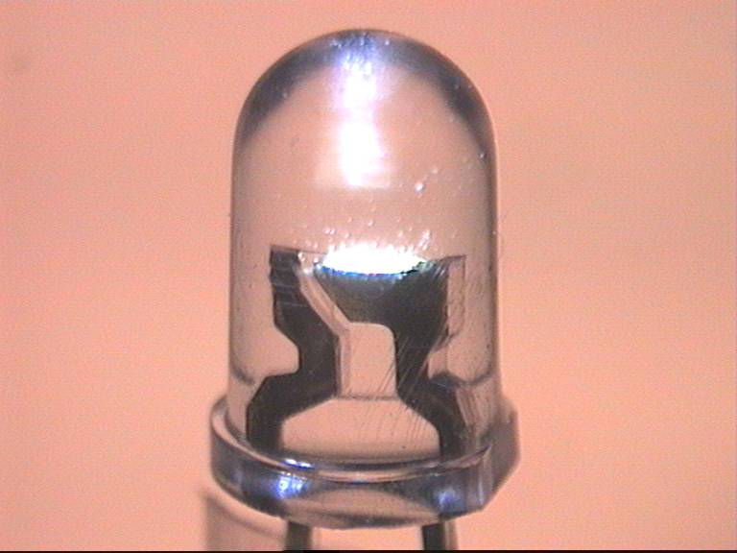
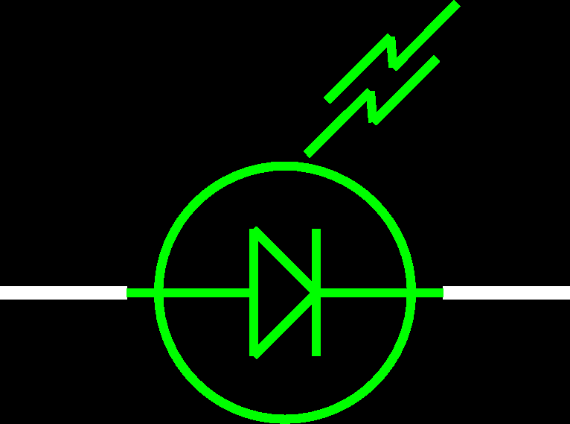
LEDs: Light-Emitting Diodes
UCSD: Physics 121; 2012
Main difference is material is more exotic than silicon used in ordinary diodes/transistors
  typically 2-volt drop instead of 0.6 V drop
When electron flows through LED, loses energy by emitting a photon of light rather than vibrating lattice (heat)
LED efficiency is 30% (compare to incandescent bulb at 10%)
Must supply current-limiting resistor in series:
  figure on 2 V drop across LED; aim for 1–10 mA of current
Winter 2012
Notes:
Electronics Overview
Lecture 8

Slide 10
Getting DC back out of AC
UCSD: Physics 121; 2012
AC provides a means for us to distribute electrical power, but most devices actually want DC
  bulbs, toasters, heaters, fans don’t care: plug straight in
  sophisticated devices care because they have diodes and transistors that require a certain polarity
    rather than oscillating polarity derived from AC
    this is why battery orientation matters in most electronics
Use diodes to “rectify” AC signal
Simplest (half-wave) rectifier uses one diode:
input voltage
AC source
load
diode only conducts
when input voltage is positive
voltage seen by load
Winter 2012
Notes:
Electronics Overview
Lecture 8

Slide 11
Doing Better: Full-wave Diode Bridge
UCSD: Physics 121; 2012
The diode in the rectifying circuit simply prevented the negative swing of voltage from conducting
  but this wastes half the available cycle
  also very irregular (bumpy): far from a “good” DC source
By using four diodes, you can recover the negative swing:
B & C conduct
input voltage
A
B
AC source
A & D conduct
C
load
D
voltage seen by load
Winter 2012
Notes:
Electronics Overview
Lecture 8

Slide 12
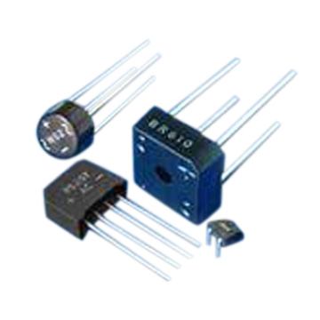
Full-Wave Dual-Supply
UCSD: Physics 121; 2012
By grounding the center tap, we have two opposite AC sources
  the diode bridge now presents + and − voltages relative to ground
  each can be separately smoothed/regulated
  cutting out diodes A and D makes a half-wave rectifier
AC source
A
B
voltages seen by loads
C
+ load
D
− load
can buy pre-packaged diode bridges
Winter 2012
Notes:
Electronics Overview
Lecture 8

Slide 13
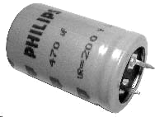
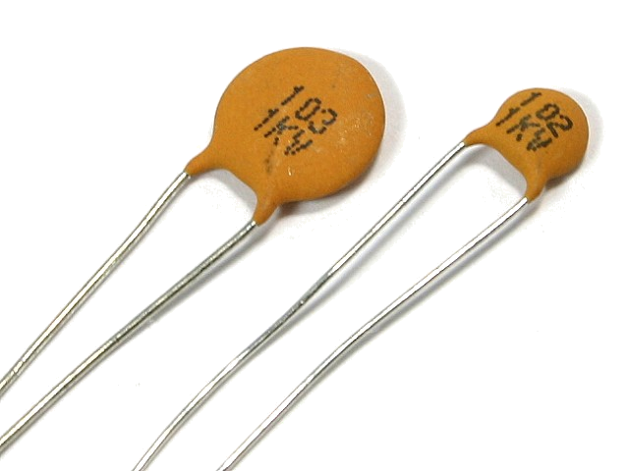
Smoothing out the Bumps
UCSD: Physics 121; 2012
Still a bumpy ride, but we can smooth this out with a capacitor
  capacitors have capacity for storing charge
  acts like a reservoir to supply current during low spots
  voltage regulator smoothes out remaining ripple
A
B
capacitor
AC source
C
load
D
Winter 2012
Notes:
Electronics Overview
Lecture 8

Slide 14
How smooth is smooth?
UCSD: Physics 121; 2012
V
An RC circuit has a time constant τ = RC
  because dV/dt = I/C, and I = V/R → dV/dt = V/RC
  so V is V₀exp(±t/τ)
Any exponential function starts out with slope = Amplitude/τ
So if you want < 10% ripple over 120 Hz (8.3 ms) timescale…
  must have τ = RC > 83 ms
  if R = 100 Ω, C > 830 μF
C
R
τ
Winter 2012
Notes:
Electronics Overview
Lecture 8

Slide 15
Regulating the Voltage
UCSD: Physics 121; 2012
The unregulated, ripply voltage may not be at the value you want
  depends on transformer, etc.
  suppose you want 15.0 V
You could use a voltage divider to set the voltage
But it would droop under load
  output impedance → R₁ || R₂
  need to have very small R₁, R₂ to make “stiff”
  the divider will draw a lot of current
  perhaps straining the source
  power expended in divider >> power in load
Not a “real” solution
Important note: a “big load” means a small resistor value: 1 Ω demands more current than 1 MΩ
V_{in}
R₁
V_{out}
1
R_{load}
R₂
3
2
Winter 2012
Notes:
Electronics Overview
Lecture 8

Slide 16
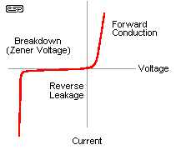
The Zener Regulator
UCSD: Physics 121; 2012
Zener diodes break down at some reverse voltage
  can buy at specific breakdown voltages
  as long as some current goes through zener, it’ll work
  good for rough regulation
Conditions for working:
  let’s maintain some minimal current, I_{z} through zener (say a few mA)
  then (V_{in} − V_{out})/R₁ = I_{z} + V_{out}/R_{load} sets the requirement on R₁
  because presumably all else is known
  if load current increases too much, zener shuts off (node drops below breakdown) and you just have a voltage divider with the load
zener voltage
high slope is what makes the
zener a decent voltage regulator
V_{in}
R₁
V_{out} = V_{z}
R_{load}
Z
Winter 2012
Notes:
Electronics Overview
Lecture 8

Slide 17
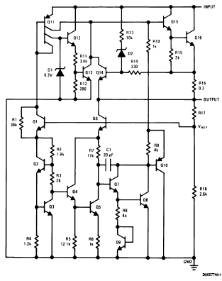
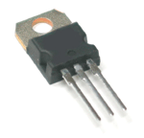
Voltage Regulator IC
UCSD: Physics 121; 2012
Can trim down ripply voltage to precise, rock-steady value
Now things get complicated!
  We are now in the realm of integrated circuits (ICs)
ICs are whole circuits in small packages
ICs contain resistors, capacitors, diodes, transistors, etc.
note zeners
Winter 2012
Notes:
Electronics Overview
Lecture 8

Slide 18
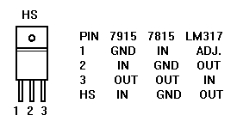
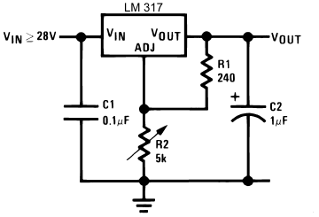
Voltage Regulators
UCSD: Physics 121; 2012
The most common voltage regulators are the LM78XX (+ voltages) and LM79XX (− voltages)
  XX represents the voltage
    7815 is +15; 7915 is −15; 7805 is +5, etc
  typically needs input > 3 volts above output (reg.) voltage
A versatile regulator is the LM317 (+) or LM337 (−)
  1.2–37 V output
  V_{out} = 1.25(1+R₂/R₁) + I_{adj}R₂
  Up to 1.5 A
  picture at right can go to 25 V
  datasheetcatalog.com for details
beware that housing is not always ground
Winter 2012
Notes:
Electronics Overview
Lecture 8

Slide 19
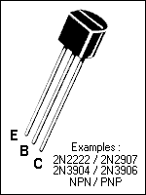
Transistors
UCSD: Physics 121; 2012
Transistors are versatile, highly non-linear devices
Two frequent modes of operation:
  amplifiers/buffers
  switches
Two main flavors:
  npn (more common) or pnp, describing doping structure
Also many varieties:
  bipolar junction transistors (BJTs) such as npn, pnp
  field effect transistors (FETs): n-channel and p-channel
  metal-oxide-semiconductor FETs (MOSFETs)
We’ll just hit the essentials of the BJT here
  MOSFET in later lecture
C
E
B
B
E
C
npn
pnp
Winter 2012
Notes:
Electronics Overview
Lecture 8

Slide 20
BJT Amplifier Mode
UCSD: Physics 121; 2012
Central idea is that when in the right regime, the BJT collector-emitter current is proportional to the base current:
  namely, I_{ce} = βI_{b}, where β (sometimes h_{fe}) is typically ~100
  In this regime, the base-emitter voltage is ~0.6 V
  below, I_{b} = (V_{in} − 0.6)/R_{b}; I_{ce} = βI_{b} = β(V_{in} − 0.6)/R_{b}
  so that V_{out} = V_{cc} − I_{ce}R_{c} = V_{cc} − β(V_{in} − 0.6)(R_{c}/R_{b})
  ignoring DC biases, wiggles on V_{in} become β (R_{c}/R_{b}) bigger (and inverted): thus amplified
V_{cc}
R_{c}
R_{b}
out
C
in
B
E
Winter 2012
Notes:
Electronics Overview
Lecture 8

Slide 21
Switching: Driving to Saturation
UCSD: Physics 121; 2012
What would happen if the base current is so big that the collector current got so big that the voltage drop across R_{c} wants to exceed V_{cc}?
  we call this saturated: V_{c} − V_{e} cannot dip below ~0.2 V
  even if I_{b} is increased, I_{c} won’t budge any more
The example below is a good logic inverter
  if V_{cc} = 5 V; R_{c} = 1 kΩ; I_{c}(sat) ≈ 5 mA; need I_{b} > 0.05 mA
  so R_{b} < 20 kΩ would put us safely into saturation if V_{in} = 5V
  now 5 V in → ~0.2 V out; < 0.6 V in → 5 V out
V_{cc}
R_{c}
R_{b}
out
in
Winter 2012
Notes:
Electronics Overview
Lecture 8

Slide 22
Transistor Buffer
UCSD: Physics 121; 2012
V_{cc}
in
out
R
In the hookup above (emitter follower), V_{out} = V_{in} − 0.6
  sounds useless, right?
  there is no voltage “gain,” but there is current gain
  Imagine we wiggle V_{in} by ΔV: V_{out} wiggles by the same ΔV
  so the transistor current changes by ΔI_{e} = ΔV/R
  but the base current changes 1/β times this (much less)
  so the “wiggler” thinks the load is ΔV/ΔI_{b} = β·ΔV/ΔI_{e} = βR
  the load therefore is less formidable
The “buffer” is a way to drive a load without the driver feeling the pain (as much): it’s impedance isolation
Winter 2012
Notes:
Electronics Overview
Lecture 8

Slide 23
Improved Zener Regulator
UCSD: Physics 121; 2012
By adding a transistor to the zener regulator from before, we no longer have to worry as much about the current being pulled away from the zener to the load
  the base current is small
  R_{load} effectively looks β times bigger
  real current supplied through transistor
Can often find zeners at 5.6 V, 9.6 V, 12.6 V, 15.6 V, etc. because drop from base to emitter is about 0.6 V
  so transistor-buffered V_{reg} comes out to 5.0, 9.0, etc.
I_{z} varies less in this arrangement, so the regulated voltage is steadier
V_{in}
V_{in}
R_{z}
V_{z}
V_{reg}
Z
R_{load}
Winter 2012
Notes:
Electronics Overview
Lecture 8

Slide 24
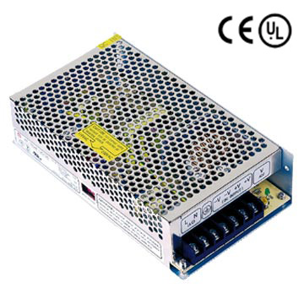
Switching Power Supplies
UCSD: Physics 121; 2012
Power supplies without transformers
  lightweight; low cost
  can be electromagnetically noisy
Use a DC-to-DC conversion process that relies on flipping a switch on and off, storing energy in an inductor and capacitor
  regulators were DC-to-DC converters too, but lossy: lose ΔP = IΔV of power for voltage drop of ΔV at current I
  regulators only down-convert, but switchers can also up-convert
  switchers are reasonably efficient at conversion
Winter 2012
Notes:
Electronics Overview
Lecture 8

Slide 25
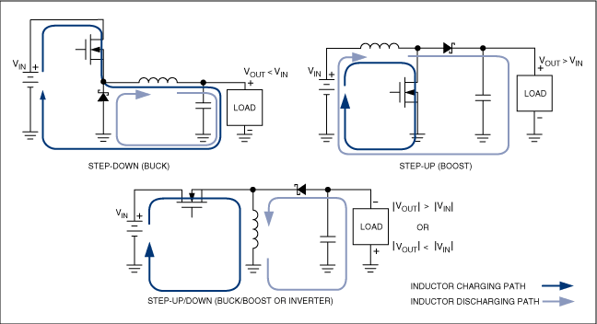
Switcher topologies
UCSD: Physics 121; 2012
The FET switch is turned off or on in a pulse-width-modulation (PWM) scheme,
the duty cycle of which determines the ratio of V_{out} to V_{in}
from: http://www.maxim-ic.com/appnotes.cfm/appnote_number/4087
Winter 2012
Notes:
Electronics Overview
Lecture 8

Slide 26
Step-Down Calculations
UCSD: Physics 121; 2012
If the FET is on for duty cycle, D (fraction of time on), and the period is T:
  the average output voltage is V_{out} = DV_{in}
  the average current through the capacitor is zero, the average current through the load (and inductor) is 1/D times the input current
  under these idealizations, power in = power out
Winter 2012
Notes:
Electronics Overview
Lecture 8

Slide 27
Step-down waveforms
UCSD: Physics 121; 2012
Shown here is an example of the step-down with the FET duty cycle around 75%
The average inductor current (dashed) is the current delivered to the load
  the balance goes to the capacitor
The ripple (parabolic sections) has peak-to-peak fractional amplitude of T²(1−D)/(8LC)
  so win by small T, large L & C
  10 kHz at 1 mH, 1000 μF yields ~0.1% ripple
  means 10 mV on 10 V
FET
Inductor
Current
Supply
Current
Capacitor
Current
Output
Voltage
(ripple exag.)
Winter 2012
Notes:
Electronics Overview
Lecture 8

Slide 28
Cable Impedances
UCSD: Physics 121; 2012
RG58 cable is characterized as 50 Ω cable
  RG59 is 75 Ω
  some antenna cable is 300 Ω
Isn’t the cable nearly zero resistance? And shouldn’t the length come into play, somehow?
There is a distinction between resistance and impedance
  though same units
Impedances can be real, imaginary, or complex
  resistors are real: Z = R
  capacitors and inductors are imaginary: Z = −i/ωC; Z = iωL
  mixtures are complex: Z = R − i/ωC + iωL
Winter 2012
Notes:
Electronics Overview
Lecture 8

Slide 29
Impedances, cont.
UCSD: Physics 121; 2012
Note that:
  capacitors become less “resistive” at high frequency
  inductors become more “resistive” at high frequency
  bigger capacitors are more transparent
  bigger inductors are less transparent
  i (√−1) indicates 90° phase shift between voltage and current
    after all, V = IZ, so Z = V/I
    thus if V is sine wave, I is ±cosine for inductor/capacitor
    and given that one is derivative, one is integral, this makes sense (slide # 3)
  adding impedances automatically takes care of summation rules: add Z in series
    capacitance adds as inverse, resistors, inductors straight-up
Winter 2012
Notes:
Electronics Overview
Lecture 8

Slide 30
Impedance Phasor Diagram
UCSD: Physics 121; 2012
Impedances can be drawn on a complex plane, with pure resistive, inductive, and capacitive impedances represented by the three cardinal arrows
An arbitrary combination of components may have a complex impedance, which can be broken into real and imaginary parts
Note that a system’s impedance is frequency-dependent
imag. axis
Z_{i}
Z
ωL
Z_{r}
real axis
R
1/ωC
Winter 2012
Notes:
Electronics Overview
Lecture 8

Slide 31
Transmission Line Model
UCSD: Physics 121; 2012
input
L
C
output
The cable has a finite capacitance per unit length
  property of geometry and dielectric separating conductors
  C/l = 2πε/ln(b/a), where b and a are radii of cylinders
Also has an inductance per unit length
  L/l = (μ/2π)ln(b/a)
When a voltage is applied, capacitors charge up
  thus draw current; propagates down the line near speed of light
Question: what is the ratio of voltage to current?
  because this is the characteristic impedance
Answer: Z₀ = sqrt(ωL/ωC) = sqrt(L/C) = (1/2π)sqrt(μ/ε)ln(b/a)
  note that Z₀ is frequency-independent
Winter 2012
Notes:
Electronics Overview
Lecture 8

Slide 32
Typical Transmission Lines
UCSD: Physics 121; 2012
RG58 coax is abundant
  30 pF per foot; 75 nH per foot; 50 Ω; v = 0.695c; ~5 ns/m
RG174 is the thin version
  same parameters as above, but scaled-down geometry
RG59
  used for video, cable TV
  21 pF/ft; 118 nH per foot; 75 Ω; v = 0.695c; ~5 ns/m
twisted pair
  110 Ω at 30 turns/ft, AWG 24–28
PCB (PC-board) trace
  get 50 Ω if the trace width is 1.84 times the separation from the ground plane (assuming fiberglass PCB with ε = 4.5)
Winter 2012
Notes:
Electronics Overview
Lecture 8

Slide 33
Why impedance matters
UCSD: Physics 121; 2012
For fast signals, get bounces (reflections) at every impedance mismatch
  reflection amplitude is (Z_{t} − Z_{s})/(Z_{t} + Z_{s})
    s and t subscripts represent source and termination impedances
    sources intending to drive a Z₀ cable have Z_{s} = Z₀
Consider a long cable shorted at end: insert pulse
  driving electronics can’t know about the termination immediately: must charge up cable as the pulse propagates forward, looking like Z₀ of the cable at first
  surprise at far end: it’s a short! retreat!
  in effect, negative pulse propagates back, nulling out capacitors (reflection is −1)
  one round-trip later (10 ns per meter, typically), the driving electronics feels the pain of the short
Winter 2012
Notes:
Electronics Overview
Lecture 8

Slide 34
Impedance matters, continued
UCSD: Physics 121; 2012
Now other extreme: cable un-terminated: open
  pulse travels merrily along at first, the driving electronics seeing a Z₀ cable load
  at the end, the current has nowhere to go, but driver can’t know this yet, so keeps loading cable as if it’s still Z₀
  effectively, a positive pulse reflects back, double-charging capacitors (reflection is +1)
  driver gets word of this one round-trip later (10 ns/m, typically), then must cease to deliver current (cable fully charged)
The goldilocks case (reflection = 0)
  if the end of the cable is terminated with resistor with R = Z₀, then current is slurped up perfectly with no reflections
  the driver is not being lied to, and hears no complaints
Winter 2012
Notes:
Electronics Overview
Lecture 8

Slide 35
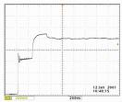
_x000c_So Beware!
UCSD: Physics 121; 2012
If looking at fast (tens of ns domain) signals on scope, be sure to route signal to scope via 50 Ω coax and terminate the scope in 50 Ω
  if the signal can’t drive 50 Ω, then use active probes
Note that scope probes terminate to 1 MΩ, even though the cables are NOT 1 MΩ cables (no such thing)
  so scope probes can be very misleading about shapes of fast signals
Winter 2012
Notes:
Electronics Overview
Lecture 8

Slide 36
References and Assignment
UCSD: Physics 121; 2012
References:
  The canonical electronics reference is Horowitz and Hill: The Art of Electronics
  Also the accompanying lab manual by Hayes and Horowitz is highly valuable (far more practically-oriented)
  And of course: Electronics for Dogs (just ask Gromit)
Reading
  Sections 6.1.1, 6.1.2
  Skim 6.2.2, 6.2.3, 6.2.4
  Sections 6.3.1, 6.5.1, 6.5.2
  Skim 6.3.2
Winter 2012
Notes:
Electronics Overview
Lecture 8

